Slide 1

Love is love. Quirks and Easter Eggs of the Python programming language.
Wojciech Szlosek

Slide 2


Introductory information
One of the most popular and universal programming languages.
Hides many secrets and non-intuitive situations.
Intuition, however, sometimes rightly fails us (as in mathematics).

Slide 3
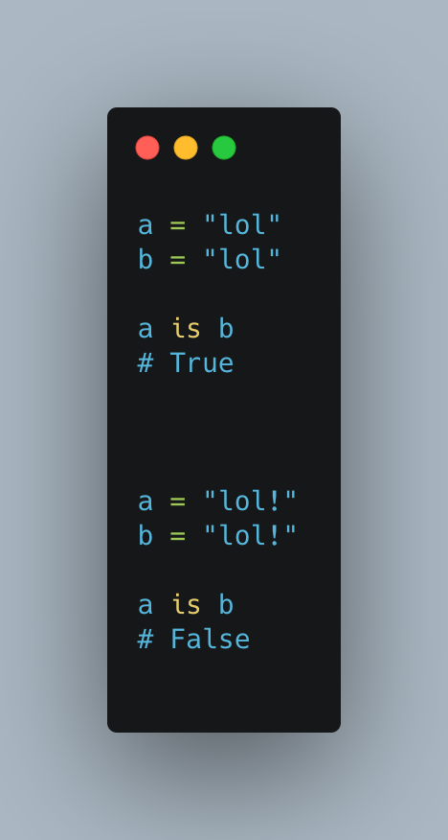
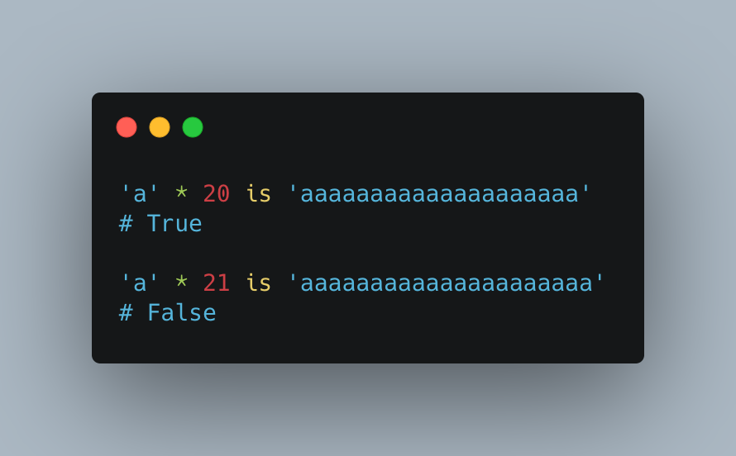
Strings are not always obvious (ex. 1 & 2).

Slide 4
Strings are not always obvious. Explanation.
Ex. 1:
CPython optimization (called string interning).
Ex. 2:
Peephole optimization technique known as Constant folding.

Slide 5
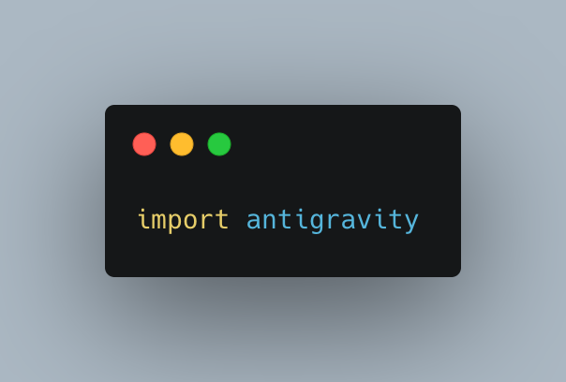
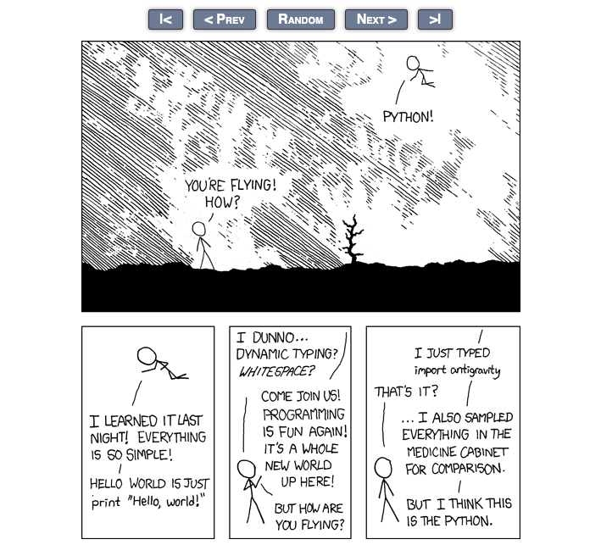
I believe I can fly.
import antigravity opens up a web browser pointing to the comic about Python
python developers easter egg
popular functionality

Slide 6
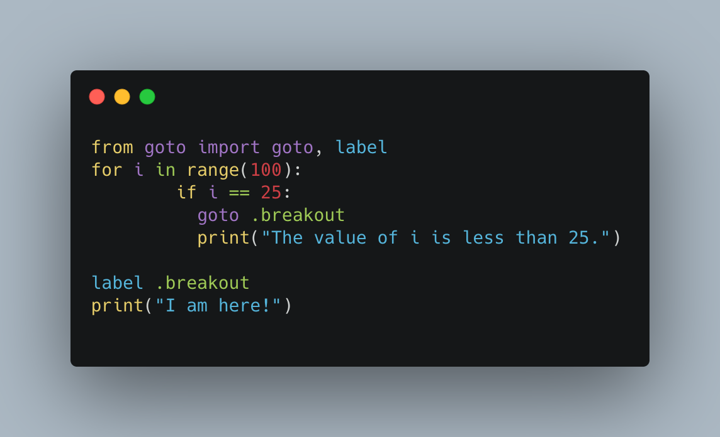
"goto" is our enemy.
"goto" is bad programming practice for all languages. It is so banned in Python that it cannot be used at this time.

Slide 7
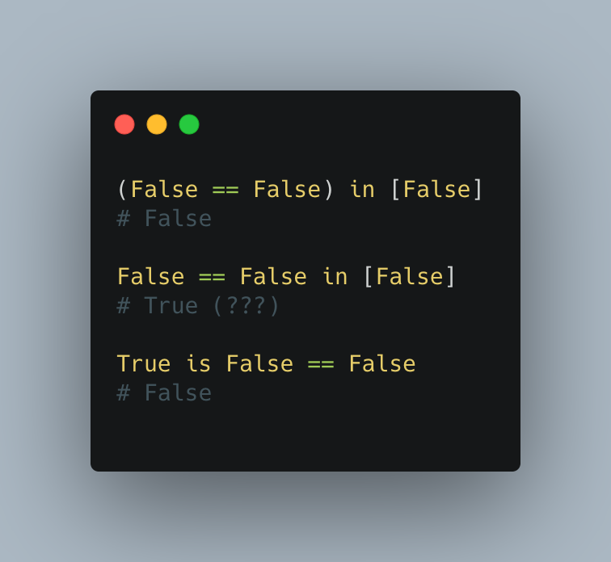
Logical operators are puzzling.
If (True) in [False] is false, why are the other cases different?

Slide 8
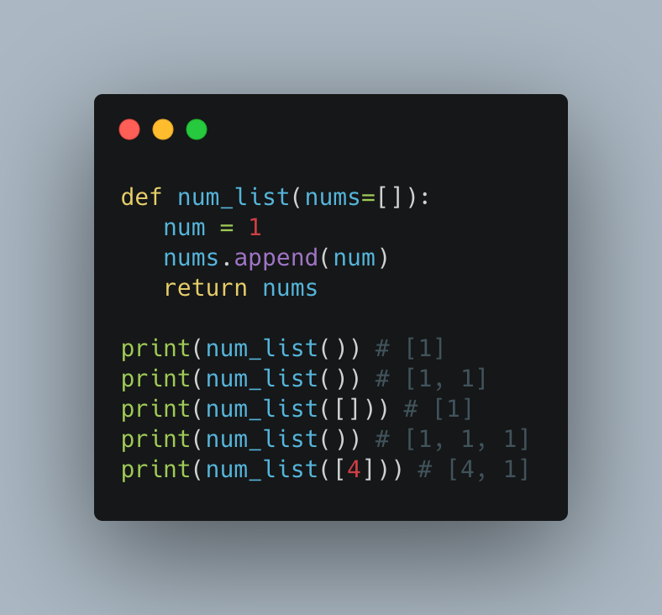
Beware of default mutable arguments.
The first two times num_list() is invoked, a 1 will be appended to nums list both times. The result is [1, 1]. To reset the list, you have to pass in an empty list to the next invocation.

Slide 9
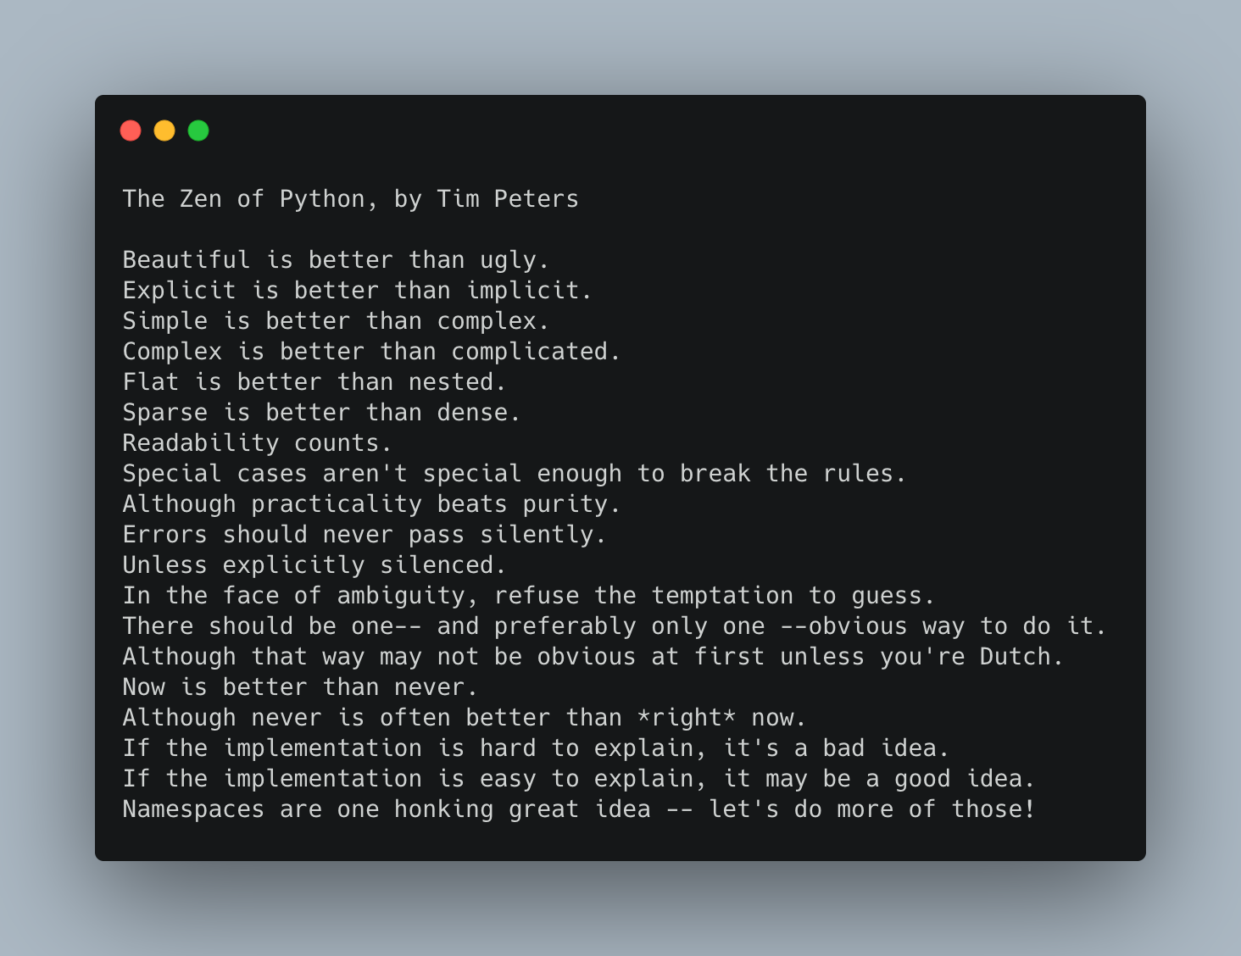
It's the Zen of Python!
After typing "insert this" we will get this "text".
The Zen of Python is a collection of 19 "guiding principles" for writing computer programs that influence the design of the Python.

Slide 10
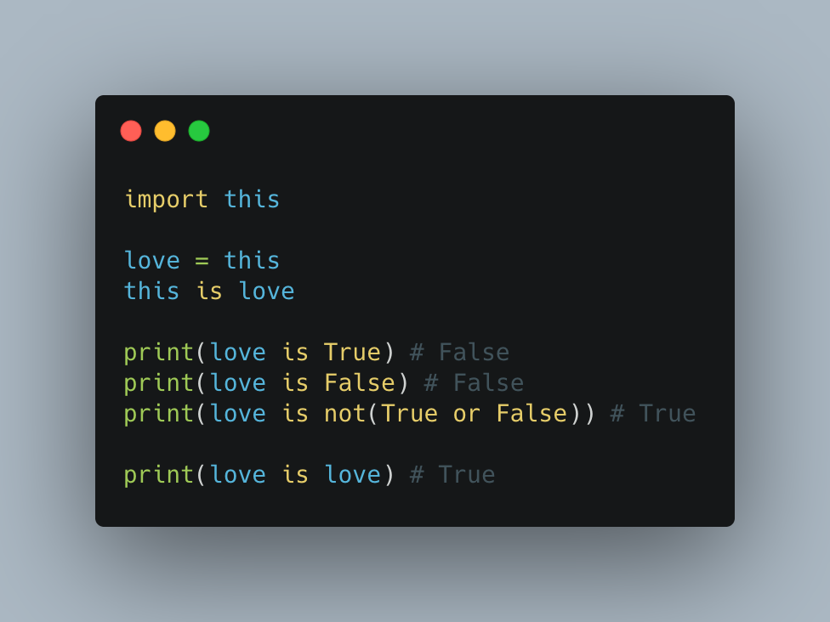
Python knows what love is.

Slide 11

Thank you for your attention.

